Slide 1
Introduction to the Distance Ladder Project
Notes:
Introduce me and my role in the course

Slide 2

Distance Ladder Project
See Blackboard / Assessment / Distance Ladder Project for
Data and instructions
Group member names
Marking rubric
These notes

Slide 3

The New Earth Universe: overview
The planet of New Earth is engulfed in one of the thickest atmospheres in the Universe.
The planet's most ambitious (and expensive) space-probe yet has taken images of the whole sky, detailed close-ups of some regions, spectrometry of each object and X-ray detections.

Slide 4
The New Earth Universe: overview
The task
Your group’s task is to investigate the astrophysics of your Universe, starting with constructing a distance ladder and calculating the Hubble constant.
You will each write a report on your group’s findings (not just your own). You may include figures/tables created by other group members, acknowledging where they are from.

Slide 5
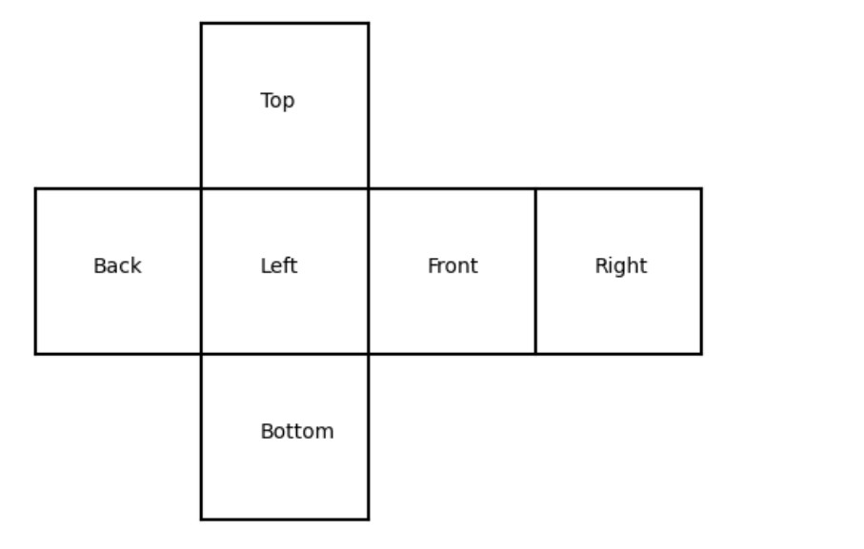
The New Earth Universe: overview
Wide-field camera layout

Slide 6
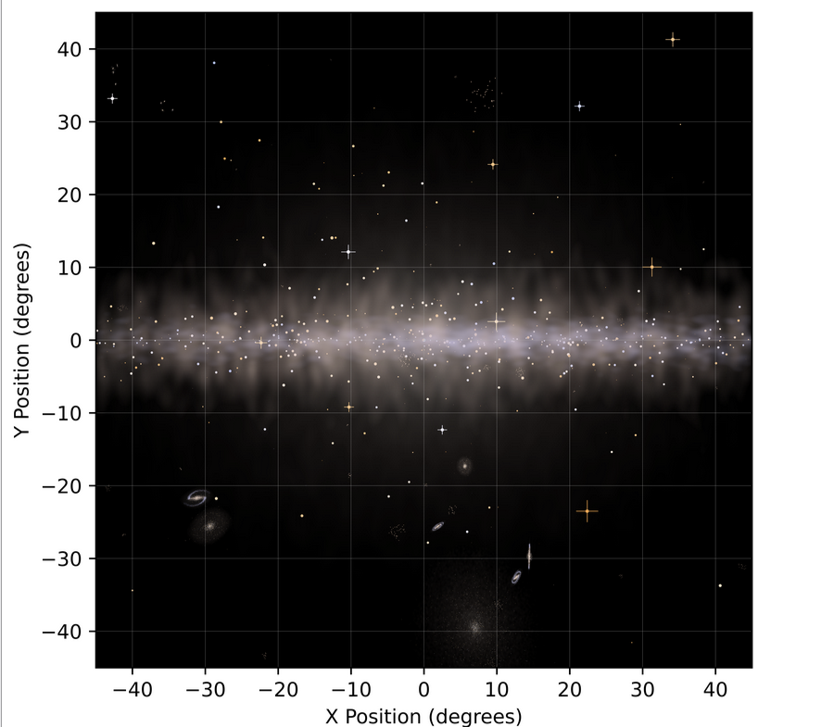
Wide-field image

Slide 7
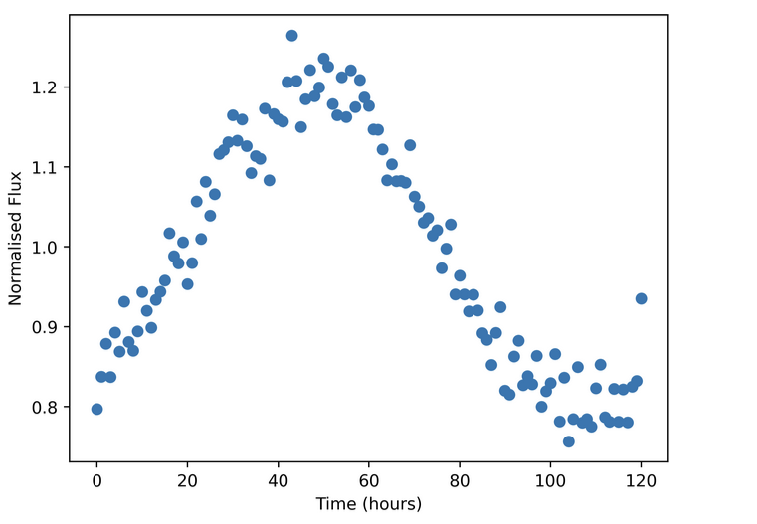
Variable sources

Slide 8
Options for your analysis (not all are required!)
Does your Universe contain galaxies? Galaxies with disks? How big are the disks (radius and thickness)? Do they have dark matter? Which galaxy does New Earth reside in? Can you produce an H-R diagram for New Earth's galaxy?
Is the cosmological principle obeyed (i.e. homogeneity and isotropy?)
What are the X-ray flashes all about? Why do they occur and how frequently?
How massive are galaxies in your Universe? How many stars per galaxy (typically)? What are the temperatures and radii of these stars? What's their mass to light ratio?
How far away are the galaxies in your Universe? More importantly: can you construct a convincing distance ladder?
Can you determine if you have any groups or clusters of galaxies? What are their populations and stellar populations like? What is the ratio of total cluster mass to luminous cluster mass? Do the galaxies contain black holes?
Compute Hubble's constant. How old is your Universe?
Only for those of you feeling very ambitious!
How did your Universe begin and what is its future? Is there life elsewhere in your galaxy or Universe?

Slide 9
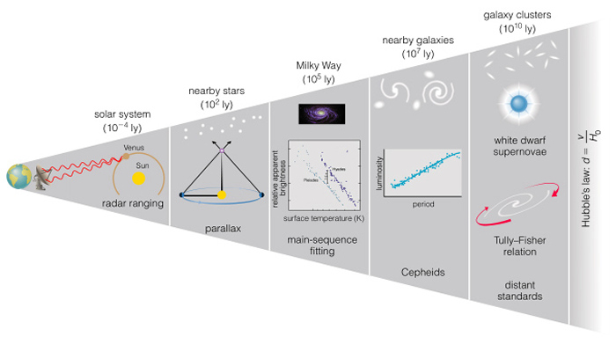
What is a distance ladder?
Schneider Ch 2.2, 3.9.
Also see discussion at end of 6.4.4.

Slide 10

Tips
Use the time wisely.
Talk to your group!
Important: Send at least one post to the group discussion board on Ed showing some results that you have obtained. The more results you can show the better. This demonstrates your ‘project contribution’ in the marking scheme.
Read the marking scheme before writing your report.
Reports should contain a title, author name, a clearly structured main body and either an abstract or a summary. Aim at writing around 10 to 15 pages. Make sure figures are properly labeled etc. Do not include lengthy data tables in your report.
Deadline for submission of DL Reports: Friday, 29th of May at 3pm

Slide 11
Questions?
Now
During workshops
On the Ed discussion board

